Slide 1
Chapter 2 Elementary Programming

Slide 2
Named Constants
final datatype CONSTANTNAME = VALUE;
final double PI = 3.14159;
final int SIZE = 3;

Slide 3
Naming Conventions
Choose meaningful and descriptive names.
Variables and method names:
  Use lowercase. If the name consists of several words, concatenate all in one, use lowercase for the first word, and capitalize the first letter of each subsequent word in the name. For example, the variables radius and area, and the method computeArea.

Slide 4
Naming Conventions, cont.
Class names:
  Capitalize the first letter of each word in the name. For example, the class name ComputeArea.
Constants:
  Capitalize all letters in constants, and use underscores to connect words. For example, the constant PI and MAX_VALUE

Slide 5

Numerical Data Types

Slide 6
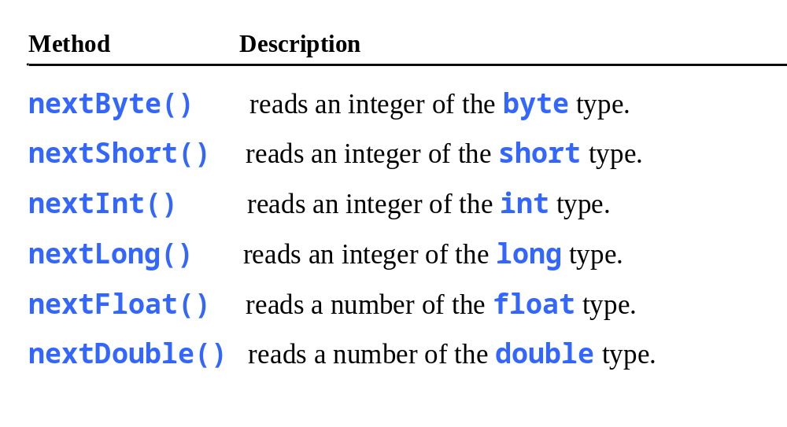
Reading Numbers from the Keyboard
Scanner input = new Scanner(System.in);
int value = input.nextInt();

Slide 7

Numeric Operators

Slide 8
Listing 2.4
Pages 43-4
ComputeAreaWithConstant.java

Slide 9
Integer Division
+, -, *, /, and %
5 / 2 yields an integer 2.
5.0 / 2 yields a double value 2.5
5 % 2 yields 1 (the remainder of the division)

Slide 10

Remainder Operator
Remainder is very useful in programming. For example, an even number % 2 is always 0 and an odd number % 2 is always 1. So you can use this property to determine whether a number is even or odd. Suppose today is Saturday and you and your friends are going to meet in 10 days. What day is in 10 days? You can find that day is Tuesday using the following expression:

Slide 11
Problem: Displaying Time
Write a program that obtains minutes and remaining seconds from seconds.
Listing 2.5 on page 47
DisplayTime
Run

